Slide 1
Communication: Individuals Experiences
Welcome to You All
From
The Voluntary Sector

Slide 2
Agenda for this Morning
Introductions
Voluntary Sector – Where we are and who we are?
Harbour Place: Brief Overview
You saw the Whole of the Moon – Elizabeth
Personal Learning from (NOT) Listening to those we support – Dave to discuss his experience
An Ex- Service Users Experience – Rob
Break
A Listening Activity - Kathryn
A Student’s perspective on listening to those we support - Fauve
Social Work England
Close

Slide 3
Introductions:

Slide 4
The Voluntary Sector
Longhurst Group
Floating Support Workers
Humberside Police
Domestic Abuse Officer
The Alzheimers Society
Agencies in the Independent Sector
Friendship at Home
St Andrews Hospice Social Workers
Addaction
Harbour Place
Humber Care

Slide 5
Harbour Place Day Centre 1996 - 2018
Harbour Place charity was formed in 1996 as a day centre for the homeless.
Purpose:
A meeting place for homeless during the day.
Support with accessing accommodation; health and wellbeing services; benefits.
Outreach support.
Night shelter 3 nights a week.
In February 2018 funding from the Big Lottery ended.

Slide 6
Harbour Place Night Shelter and Outreach Service 2018 – to Present
In September 2018 Harbour Place moved to premises in Hope Street and opened a night shelter and street outreach service for rough sleepers.
Funded the government’s RSI initiative.
4 Outreach Workers, 14 Staff in total.
Provides harm reduction advice and support through our Addaction worker.
Night shelter for up to 15 people, 52 weeks of the year.
Coordinate the Official Rough Sleeper Count and SWEP.
Since 2005 Harbour Place has provided placements for 23 social work students.

Slide 7
You Saw the Whole of the Moon

Slide 8
You Saw the Whole of the Moon AUGUST 17 2019 COMMUNITYSOCIALWORKERRMEJ LAST Quango in Halifax

Slide 9
Personal Learning: Dave’s experience

Slide 10
An Ex- Service User’s Experience: Rob

Slide 11
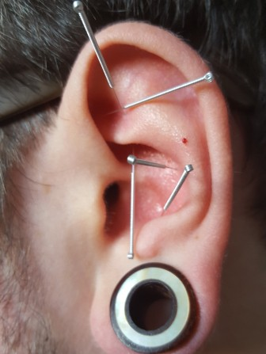
Acu-Detox

Slide 12
Tea and Coffee Break

Slide 13
Listening Exercise

Slide 17
A Student’s perspective on listening to those we support: Fauve

Slide 18
December Forum: Social Work England
The transfer to Social Work England takes place on 2nd December.
Ahmina Akhtar - Social Work England Regional Engagement Officer coming to the next Social Work forum on 10th December.
A great opportunity to ask Ahmina questions.
Website https://socialworkengland.org.uk/
SWE consultations there are 3 at present:-
Continuing Professional Development
Fitness to Practice
Registrations

Slide 19
Contacts
Future Dates
Social Work England Website: https://soialworkengland.org.uk/
Social work England Twitter: ‎
@SocialWorkEng
Skills for Care Website:
www.skillsforcare.org.uk
adass Website:
https://www.adass.org.uk/home
adass Twitter: ‎
@1adass
adass Yorkshire and Humber Website:
https://www.adass.org.uk/community/yorkshire-and-humberside-region
Centre4
9.30 a.m. – 11.30 a.m.
10 December 2019
17 March 2020

