Slide 1
Irena Sendler’s Story
Notes:
Sinead and I attended some training recently with Siobhan Maclean. As part of the training Siobhan told us about a very inspiring, famous social worker and unbelievably none of us had ever heard of her. So we want to ask you the same question she asked us – Do you know a famous nurse??? (Show of hands). How many of you know a famous social worker? (get some feedback). Okay so a lot more people know of a famous nurse than a social worker and yet we are all social workers. The aim of our short presentation today is to ensure that if you are ever asked that question again you will most certainly raise your hand!

Slide 2
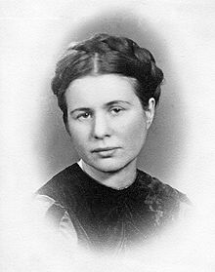
Irene Sendlerowa (nee Krzyzanowska) known as Irena Sendler
15/2/1910 – 12/5/2008
Born 15 miles outside Warsaw, Poland
Daughter of one of the first Polish socialists
Born into a Catholic Polish family
Notes:
So without further ado let me introduce you to Irena. Irena was born in 1910 in Poland. She was the daughter of one of the first polish socialists and was born into a Polish catholic family. Irena was an only child.

Slide 3
Social Work
At 17 Irena recalled “I wanted to study something concerning social care” She studied law at the University of Warsaw
She changed to a Humanities Faculty to do Polish studies involving a course in pedagogy
NQSW! At a Mother and Child Aid Section
Notes:
Irena started her further education at the University of Warsaw studying law after she identified that she wanted to study something concerning social care. She later made the decision to change to Polish studies which involved a course in Pedagodgy. When she finished her learning she gained employment as a ‘social worker’ at a mother and child aid section.

Slide 4
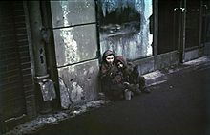
German Invasion
Germany invaded Poland in 1939
The Nazis herded hundreds of thousands of Jews into the Warsaw Ghetto, where disease, squalor and starvation were common place
Notes:
In 1939 Germany invaded Poland. Irena began helping Jews by offering them food and shelter. In 1940 the Warsaw Ghetto was formed and the Germans used this to keep thousands of Jews there in awful conditions where disease and starvation were common. This meant that Irena could no longer help the Jews in the way she had been previously. She wanted to find a new way to help them.

Slide 5
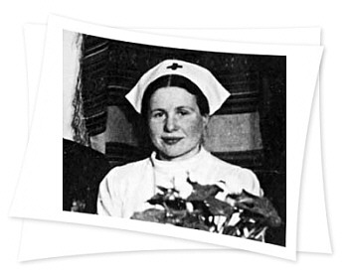
Irena’s Work
Irena was a social worker in the Warsaw Social Welfare Department
She gained a pass from the Epidemic Control Department to continue to enter the ghetto
She dressed as a nurse when social welfare was banned by the Nazis in order to visit daily to bring food, medicine and clothing to the Jews
Notes:
By this time Irena was a social worker in the Warsaw Social Welfare department. Initially she was allowed to enter the ghetto and gained a pass from epidemic control to continue to do so. Social welfare was then banned by the Nazi’s and she was no longer able to access the Ghetto. Because there were may diseases and outbreaks of infection within the Ghetto nurses were still allowed access by the guards. Irena therefore came up with the idea of dressing as a nurse to continue to access the Ghetto in order to bring provisions to the Jews.

Slide 6
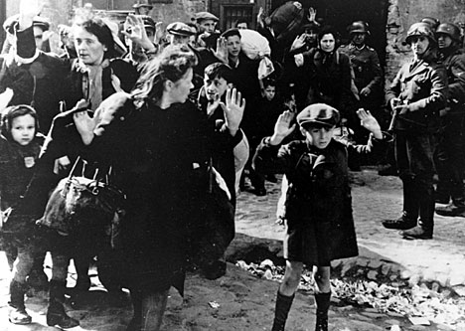
Irena’s Plan
Irena recognised the peril that Jewish children were in
She persuaded reluctant Jewish mothers to part with their children
She found Polish families prepared to take in Jewish children and raise them as Christians
Notes:
During Irena’s time in the Ghetto she became focused on the children who were in peril. Irena knew that the Jews being kept in the Ghetto would be killed, including the children. She wanted to save as many children as possible from death. She began persuading Jewish mothers to part with their children, and they were of course very reluctant. Irena identified Polish families who were willing to raise the children as Christians.

Slide 7
Irena and the Resistance
As part of the Zegota resistance she worked with the Polish underground
They smuggled children out of the ghetto in body bags, buried in goods carts, in sacks of potatoes, and even in coffins and in a mechanics toolbox
She gave children false identities
She carefully noted original names and new identities in coded form
She placed this information in jars and buried the jars beneath an apple tree
She smuggled 2,500 children to safety
Notes:
Irena used various methods to smuggle the children out of the Ghetto – in body bags, sacks of potatoes, coffins and even toolboxes. Children were given false identities, however Irena wanted the children to know where they had come from so she carefully noted all the children’s original names & new identities in code form. She was the only one who knew the code. She buried this information in jars beneath an apple tree. Irena saved 2500 children from certain death.

Slide 8
Grieving Parents
“Can you guarantee they will live?” asked distraught parents. Irena could only guarantee they would die if they stayed. “In my dreams” Irena said, “I still hear the cries when they left their parents”
Notes:
Of course the work which Irena was doing for the children and her parents was highly emotive. Irena did not want to tell the Jewish parents that she was sure the children would die if they stayed because she would diminish any hope they had of survival, but still had to somehow convince the parents to hand the children over to her. Parents and children were obviously distraught and this stayed with Irena throughout her life. She stated in later life “I still hear the cries when they left their parents”.

Slide 9
Notes:
We would now like you to take a few moments to watch a clip from the film ‘The Courageous Heart of Irena Sendler’

Slide 10
The Price She Paid
In 1943 Irena was arrested by the Gestapo
She was severely tortured, and sentenced to death as she refused to betray her associates or any of the children in hiding
Zegota saved her by bribing German guards on the way to her execution
She was left in the woods, unconscious and with broken arms and legs
For the rest of her life she had mobility problems because of this
Notes:
Unfortunately in 1943 Irena was arrested. She was tortured severely. She was taken out to the woods to be shot but a bribe was given to the German guards by the Zegota which is a Polish council to aid Jews. Although Irena survived she was left with mobility problems for the rest of her life as a result.

Slide 11
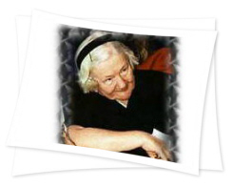
After the War
After the war she dug up the jars and used the notes to track down the children she placed with adoptive families and to reunite them with relatives scattered across Europe
Most lost their families during the Holocaust in Nazi death camps
The children had known her only by her code name Jolanta. But years later, after she was honored for her wartime work, her picture appeared in the newspaper. “A man, a painter, telephoned me,” said Sendler, ‘I remember your face,’ he said. ‘It was you who took me out of the ghetto.’ I had many calls like that!”
Notes:
After the war she dug up the jars with the children’s original identities inside and was able to track them down and reunite them with biological family members, however, most of the children lost their families during the Holocaust. She had a code name which the children knew her by and years later when honoured in the paper some of the children came forward after recognising her.

Slide 12
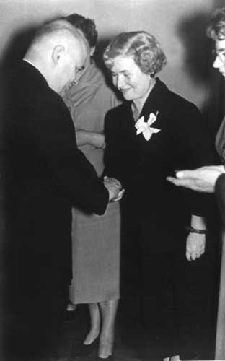
Awards
Yad Vashem the Holocaust Martyrs and Heroes. Remembrance Authority in Jerusalem recognises Irena as a righteous Gentile
1983 Yad Vashem plants a tree in her honour
1991 Irena was made an honorary citizen of Israel
2003 Irena receives a letter from the Pope recognising her work and was awarded Poland’s highest honour, the Order of the White Eagle
2004 Irena is recognised by President of Poland
2007 Irena is nominated for the Nobel Peace Prize by the Polish president he referred to her as “a great heroine who can be justly named for the Nobel Peace Prize. She deserves great respect from our whole nation”
These are just some of the awards she received
Notes:
Irena received many awards for her brave actions. She was made an honoury citizen of Israel and was recognised by the Pope and president of Poland for her work . In 2007 she was nominated for a Nobel Peace Prize.

Slide 13
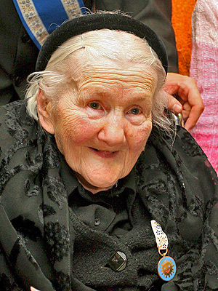
Irena said “I was taught that if
you can see a person
drowning, you must jump into
the water to save them,
whether you can swim or not”
Irena died on 12 May 2008 at the age of 98 in a Warsaw Nursing Home cared for by one of the children that she smuggled out of the ghetto. She had three children, two sons who both died, and a daughter.
Notes:
Irena died in 2008 at the age of 98 in a Warsaw nursing home cared for by one of the children she smuggled out of the Ghetto.

Slide 14
https://www.youtube.com/watch?v=2QSf0MraA_A
Notes:
https://www.youtube.com/watch?v=2QSf0MraA_A
We would like to end with video of Irena talking in later life about her time in the Ghetto.

